Slide 1
USING DATA MINING TO PREDICT SECONDARY SCHOOL STUDENT PERFORMANCE
Md. Easin Arafat
011 152 047
Irfan Ahmed
011 151 174
Bimurta Bismoy Sanchi
ID: 011 151 285

Slide 2
Authors:
Paulo Cortez and Alice Silva
Dept. Information System/Algoritmi R&D Center,Portugal

Slide 3
Abstract

Slide 4
This paper is published based on -
Lack of success in the core classes of Mathematics and the Portuguese language.
An explanatory analysis shown that there are other relevant features have effect on the students failure like -
Number of absence
Parents job and education
Alcohal consumption

Slide 5
Intends :
The present works intends to approach student achievements in secondary education using BI/DM as BI/DM aim at -
Extracting high level knowledge from raw data
Offer interesting autometed tools that can aid the education domain

Slide 6
Data Collection :
ecData Colltion :
Student grades
Demographic
Social and school related features using school reports and questionaires

Slide 7
Used Models & Algorithms :
4 kinds of DM models were used to test the accurancy. Those are -
Decission tree
Random forrest
Nueral networks
Support vector machine
Also Two core classes Mathematics and Portuguese were modeled by -
binary classification
five lebeled classification and regression

Slide 8
Results :
As direct outcomes of this paper -
A good predictive accurancy can be achived
More efficient student prediction tools can be developed
Improving the quality of education
Enhancing school resource management

Slide 9
Introduction

Slide 10
For long term economic progress, education is must. Their statistics tells that their position is in the tail ends of Europe
Here are some statistics -
In 2006, early school leaving rate in portugal was 40% for 18 to 24 years whereas in European Union average value was just 15%

Slide 11
Focused Questions:
This paper will focus on two questions -
Is it possible to predict student performance?
What are the factors that affect student achivements?

Slide 12
Related Works:
In 2003, (Minae - Bidgoli) Michigan State University's students online grades were modeled using 3 classification approches -
binary : pass/ fail ( 94% accuracy)
3- level : low, mid, high ( 72% accuracy)
9- level : 1- lowest to 9- highest (62% accuracy)
database sample : 227
features : number of corrected answer tries for homework
algorithm : Decision trees & Neural networks

Slide 13
Related Works :
In 2004, (Kotsiants) predicted the performance of computer science students was modeled using -
binary classification (74% accuracy)
features : several demographic attributes & performance attributes
algorithm : Naive bayas

Slide 14
Aim:
Predict student achievement
If possible to identify the key variables that affect educational success/failure

Slide 15
Work Progress:
Two core classes Mathematics and Portuguese were modeled individually with - 1. binary classification 2. five labelled classification Steps of the approches -
i. 3 period grades G1(1st), G2(2nd), G3(3rd) were formed. ii. Classified G1, G2 and G3 by binary : pass / fail and by five labelled : l(excellent), ll(good), lll(satisfactory), lV(sufficient), V(fail) iii. 3 inputs --> A => G1 and G2 B => G1 and G3 C => G2 and G3 algorithms were applied in these inputs and tested the accuracy rates.

Slide 16
Data Collection and Sources

Slide 17
Data Collection and sources
This data was collected during 2005-2006 school year from two Portuguese secondary public school.
Dataset was built from two sources
- School Reports
- Based on paper sheets and including few attributes and questionnaires

Slide 18
Data Collection and sources
Final version contained 37 questions and it was answered by 788 students
111 answers were discarded due to lack of identification details
Finally, the data was integrated into two datasets
related to-
Mathematics
Portuguese Language

Slide 19
Dataset Description

Slide 20
Dataset Description:
Among all the 33 attributes,
Binary(13 variables)
e.g; male/female
Numeric(16 variables)
e.g; from 1 – very low to 5 – very high
Nominal(4 variables)
e.g; Job title, Name

Slide 21
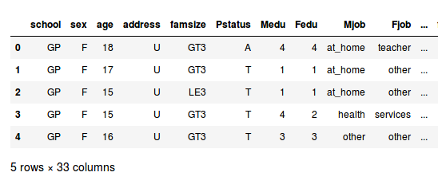
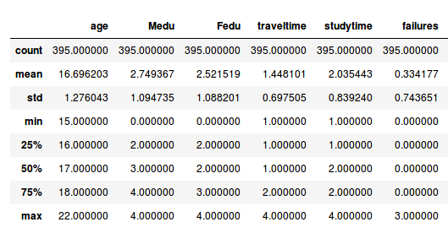
Mathematics Dataset :
In mathematics dataset, there are 33 features along with 395 instances

Slide 22
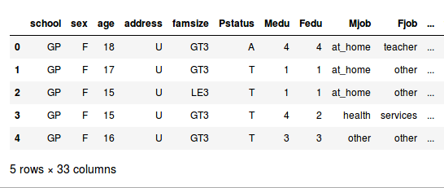
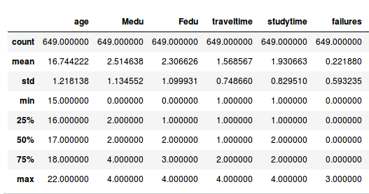
Portuguese language Dataset :
In Portugues language dataset, there are 649 instances also along with 33 features
Model Description

Slide 23
Model Description

Slide 24
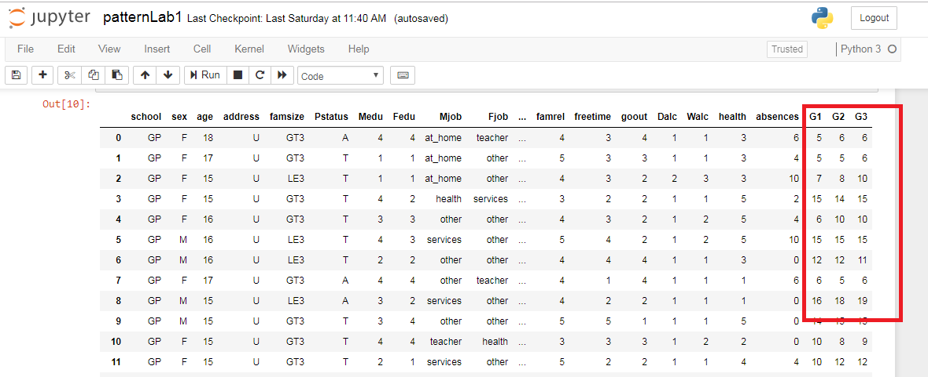
Data set

Slide 25
Approaches
Binary Classification
5 level Classification
Regression

Slide 26
Binary Classification
If (G3>=10)
{pass}
else {fail}

Slide 27
5 Level Classification
Value of G3 | Grades
16-20 | excellent (A)
14-15 | good (B)
12-13 | satisfactory (C)
10-11 | sufficient (D)
0-9 | fail (F)

Slide 28
Regression
The regression is based on G3 value
Numeric out put between 0-20

Slide 29
Predictive Performance
Three input configuration were tested for each
DM model
A Know G1 and G2
B Drop G2
C Drop G1 and G2

Slide 30
PCC Value
Ф (i) = if(1) then yi = !yi
else 0
N
PCC = Σ Ф (i)/N *100 (%)
i=1

Slide 31
yi denotes the predicted value for ith example
A high PCC value suggest a good classifier

Slide 32
Descriptive Knowledge (Bin,Mat)
Input setup | NV | NN | SVM | DT | RF
A | 91.9 | 88.3 | 86.3 | 90.7 | 91.2
B | 83.8 | 81.3 | 80.5 | 83.1 | 83.0
C | 67.1 | 66.3 | 70.6 | 65.3 | 70.5

Slide 33
(Bin-Port)
Input setup | NV | NN | SVM | DT | RF
A | 89.7 | 90.7 | 91.4 | 93.0 | 92.6
B | 87.5 | 87.6 | 88.0 | 88.4 | 90.1
C | 84.6 | 83.4 | 84.8 | 84.4 | 85.0

Slide 34
(5 level-mat)
Input setup | NV | NN | SVM | DT | RF
A | 78.5 | 60.3 | 59.6 | 76.7 | 72.4
B | 60.5 | 49.8 | 47.9 | 57.5 | 52.7
C | 32.9 | 30.4 | 31.0 | 31.5 | 33.5

Slide 35
5 level Potuguese
Input setup | NV | NN | SVM | DT | RF
A | 72.9 | 65.1 | 64.5 | 76.1 | 73.5
B | 58.7 | 52.0 | 51.7 | 62.9 | 55.3
C | 31.0 | 33.7 | 34.9 | 32.8 | 36.7

Slide 36
Computational environment
Jupyter Note book
Python 3

Slide 37
Data Visualization
def performance(value):
if value< 10:
return 'Fail'
else:
return 'pass'

Slide 38
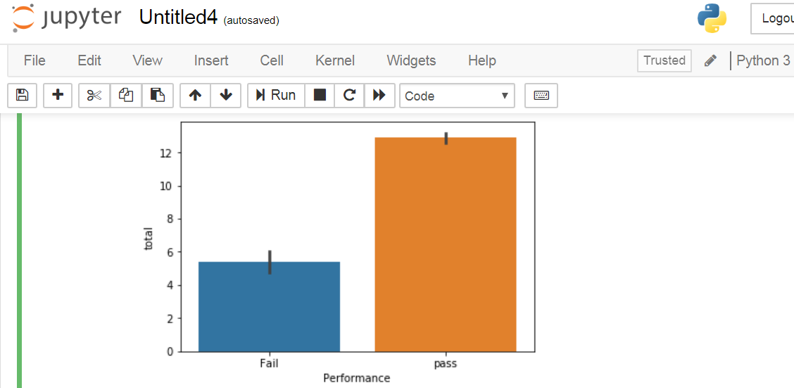
Performance

Slide 39
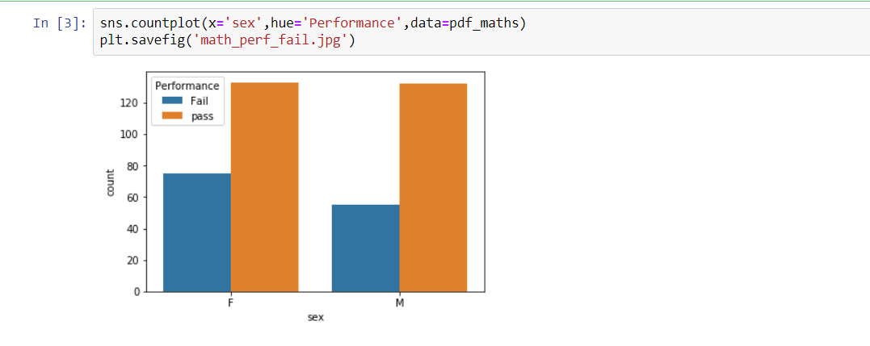
Performance based on gender

Slide 40
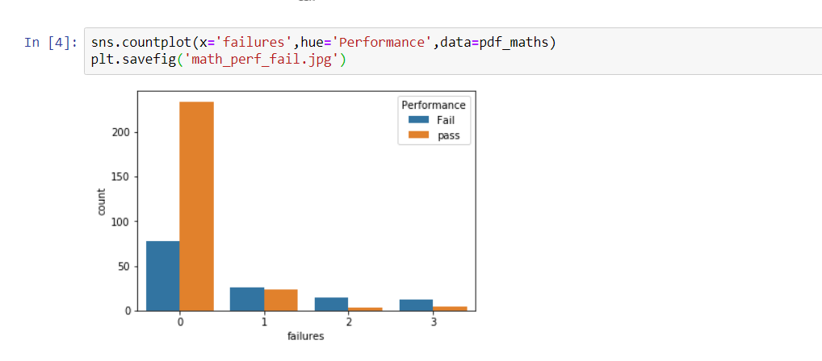
Performance based on Failure

Slide 41
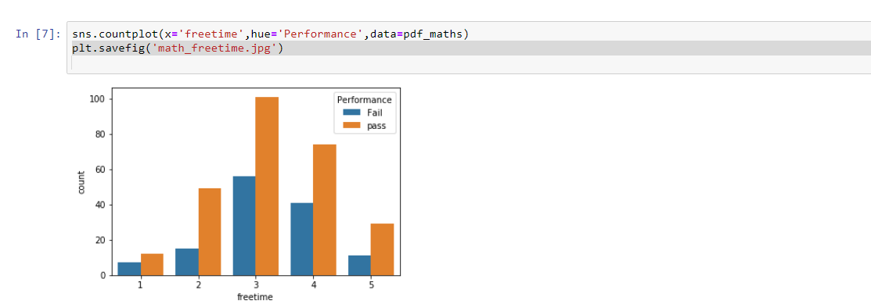
Performance based on free times

Slide 42
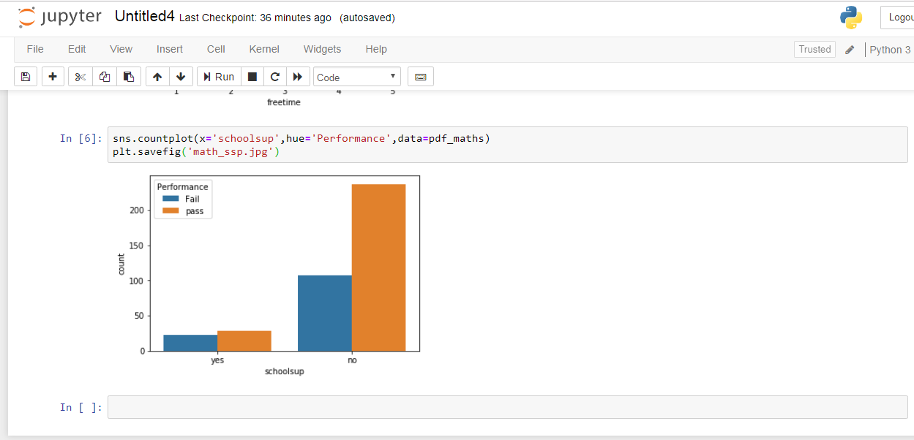
Performance based on schoolsup

Slide 43
Split Data
Training and Test
Test Size 0.2
395 rows
Test = (395*20)/100 =79

Slide 44
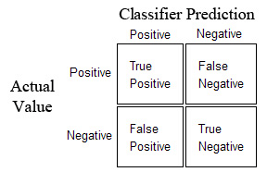
Confusion Matrix

Slide 45
Encode
For each feature, encode to categorical values
Encode G1, G2, G3 as pass or fail binary values

Slide 46
Train our Classifaier
Support Vector Machine Classifier model
Clf = SVC ()
Clf.fit(x_train,y_train)
y_train = pop(G3)
x_train = full data set with features

Slide 47
3 step calculation
Model Accuracy Knowing G1 & G2 Scores
Model Accuracy Knowing Only G1 Score
Model Accuracy Without Knowing Scores

Slide 48
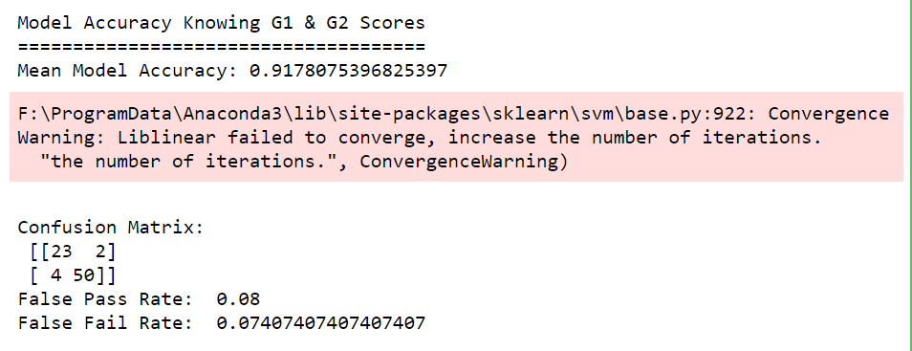
Output for Calculation1

Slide 49
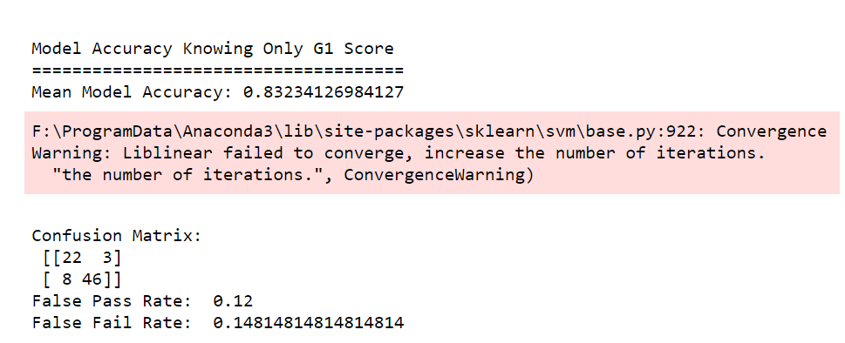
Output for Calculation2

Slide 50
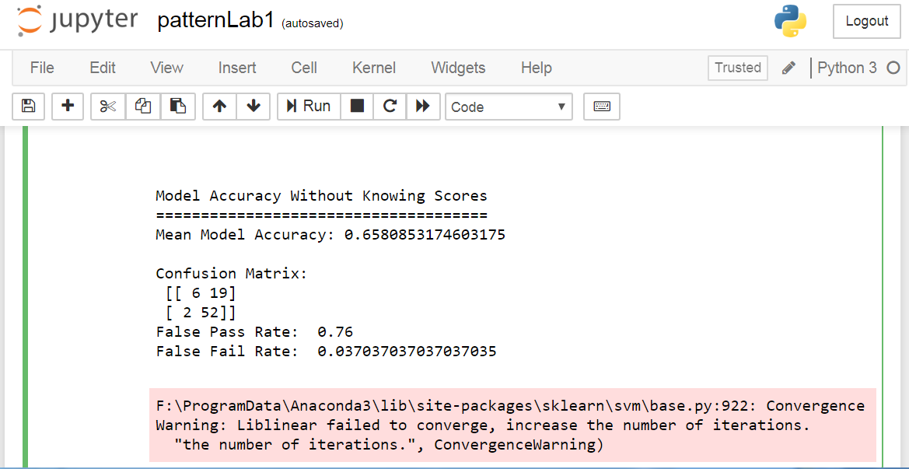
Output for Calculation3

Slide 51
Future work
Apply DT
Calculate the output
Collect real data from educational institution if possible.

Slide 52
Code links
https://github.com/tarunchhabra06/Student-Performance/blob/master/Project_Math_tchhabr2.ipynb?fbclid=IwAR1u9CqEVf26Zpr8a3wQ-8DY1jDcO-mQLtEsim4Mo-Xsj5BGdTnyd0T4vCI
https://github.com/sachanganesh/student-performance-prediction/blob/master/model.py

